Slide 1
Raspberry Pi (RPi) Custom Brew Controller Preliminary Design
Brian Thompson
04/16/2020

Slide 2
Copyright
Copyright © 2020 by Brian C Thompson
All rights reserved.
For permission requests, write to the author, addressed “Attention: Permission Request,” at the email address below.
Brian C Thompson
Brian.C.Thompson@gmail.com
www.BT.BeerProjects.com

Slide 3
Major Components
1 110AC Chugger Pump
1 110AC Heat Stick
2 12V Ball Valves
5 One-Wire Temp Sensors
2 12V pumps (recirculation and chiller)
1 PC Power Supply (12V and 5V outputs
1 Raspberry Pi v3

Slide 4
Design Goals
Switch between manual control (switches/buttons) and automated RPi control
Indicators (LEDs) for all status points
RPi inputs for all status points
Protect all RPi inputs and outputs from Overvoltage
Connectors for all switches, LEDs, wires leaving the main boards (not shown in circuits)

Slide 5
Panel Layout
RPI
Recirc Pump
Chiller Pump
Chugger Pump
5V
On
On
On
12V
On
Off
Auto
On
Off
Auto
On
Off
Auto
On
Off
Auto
En
Auto
En
Auto
En
Heating
Element
Valve 1
Valve 2
Open
Open
On
Closed
Closed
On
Off
Auto
Open
Closed
Auto
Open
Closed
Auto
Auto
En
Auto
En
Auto
En
7” Display

Slide 6
CMD/TLMList
TLM |  | Commands
Element Auto En Status (OptoTLM) | Sheet 5 | Element Auto On CMD | Sheet 5
Element On/Off Status (OptoTLM) | Sheet 5
Chugger Auto En Status (OptoTLM) | Sheet 5 | Chugger Auto On CMD | Sheet 5
Chugger On/Off Status (OptoTLM) | Sheet 5
Valve 1, Open/Closed Status | Sheet 6 | Valve 1 Auto Open/Closed CMD | Sheet 6
Valve 1, Auto En Status | Sheet 6
Valve 2, Open/Closed Status | Sheet 6 | Valve 2 Auto Open/Closed CMD | Sheet 6
Valve 2, Auto En Status | Sheet 6
Recirc Pump On/Off Status | sheet 4 | Recirc Pump On CMD | sheet 4
Chiller Pump On/Off Status | sheet 4 | Chiller Pump On CMD | sheet 4
1 Wire | Sheet 7
Temp 1 | Mash tun in
Temp 2 | Mash tun out / pump out
Temp 3 | Rover, mash tun inside
Temp 4 | Herms kettle
Temp 5 | Main Kettle

Slide 7
AC Power and RPi On/Off Switch
LEDs for each power connector
Common 12V and 5V rails across all connectors
ON/Off switch for RPi
PC Power supply includes connector
Mount Power supply facing out to access connector
Components
Power Supply
RPi

Slide 8
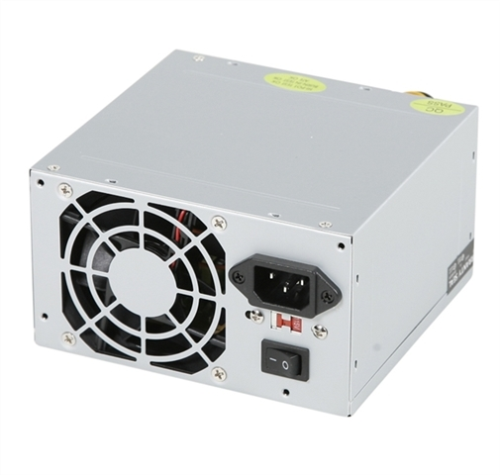
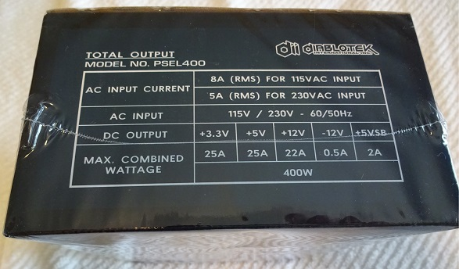
Power Supply
Specifications
General Specifications
Form Factor | ATX
Color | Silver
Wattage | 400 Watts
Cooling Fans | 80mm Fan
Safety Standards | FC. CE. RoHs Compliant
Drive/Power Connectors
Modular | No
ATX Connector | 20+4-pin
ATX 12V Connector | 1 x 4-pin
Molex Connector | 3
SATA Connector | 2
Floppy Connector | 1
Power Specifications
Efficiency | Up to 78%
Input Voltage | AC 115V/230V
Hold-up Time | 16ms
+12V Rails | 1
Physical Specifications
Dimensions (WxDxH) | 5.8" x 6" x 3.5"

Slide 9
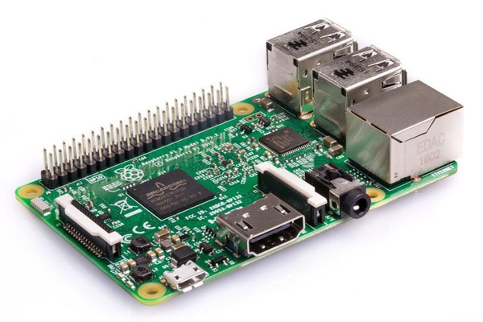
RPi
Raspberry Pi 3 Model B v1.2
Quad Core 1.2GHz Broadcom BCM2837 64bit CPU
1GB RAM
BCM43438 wireless LAN and Bluetooth Low Energy (BLE) on board
100 Base Ethernet
40-pin extended GPIO
4 USB 2 ports
4 Pole stereo output and composite video port
Full size HDMI
CSI camera port for connecting a Raspberry Pi camera
DSI display port for connecting a Raspberry Pi touchscreen display
Micro SD port for loading your operating system and storing data
Upgraded switched Micro USB power source up to 2.5A

Slide 10
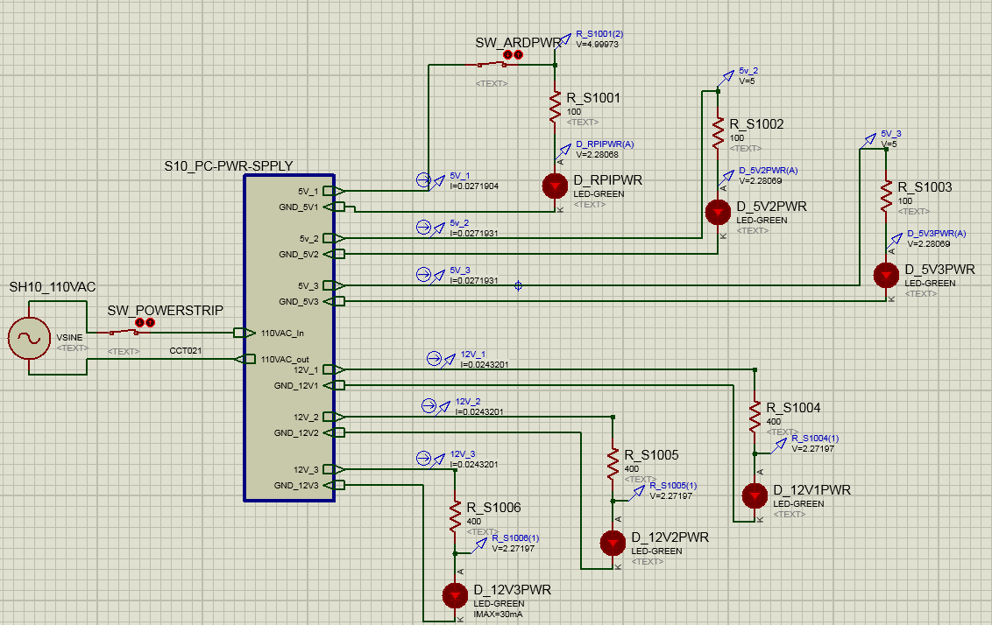
RPI On

Slide 11
RPi Off

Slide 12
Recirculation and Chiller Pump
DPDT switch shows as two switches
Copy of the circuit for each component
Components
Recirculation Pump
Chiller Pump

Slide 13
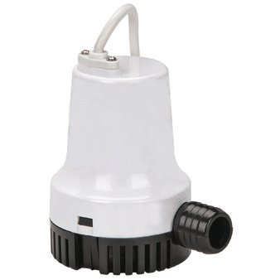
Recirculation Pump
PACIFIC HYDROSTAR 1000 GPH 12V Bilge Pump
Easy-to-clean snap lock strainer, exclusive moisture-proof seals
Anti-airlock protection and stainless steel shaft to prevent burnout
SKU: 66095
Brand: Pacific Hydrostar
Maximum flow: 1000 GPH (gallons per hour)
Head lift (ft.): 13 ft.
Amperage (amps): 5.5
Requires 15 amp fuse protected power supply
float switch recommended, not included.
DC Volts: 12
Outlet fitting size: 1-1/8 in.
Product Height: 4-3/4 in.
Product Width: 3-1/2 in

Slide 14
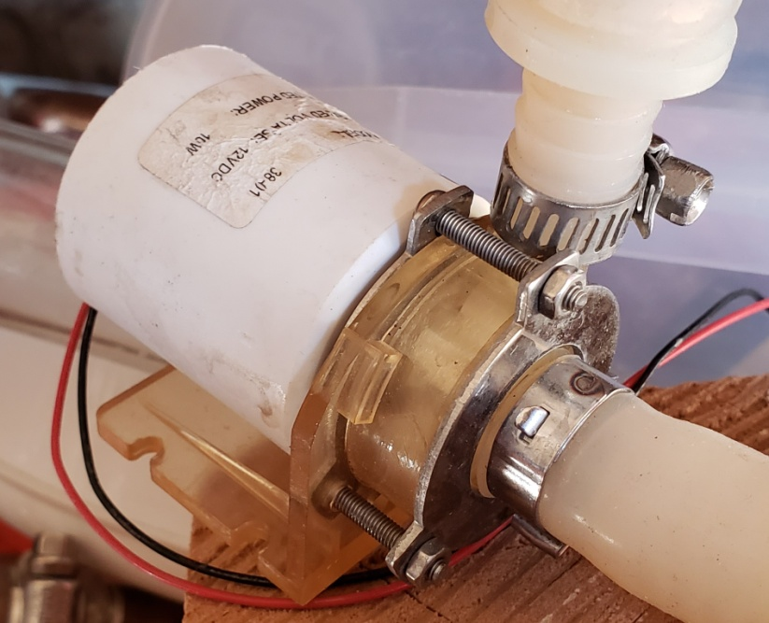
Chiller Pump
12VDC
Current = 0.83A
Power = 10W
Not actual Image

Slide 15
Recirculation and Chiller Pump Manual On
In/out reversed

Slide 16
Recirculation and Chiller Pump Manual Off
In/out reversed

Slide 17
Recirculation and Chiller Pump Auto On
In/out reversed

Slide 18
Recirculation and Chiller Pump Auto Off
In/out reversed

Slide 19
Valve Control
DPDT switch shows as two switches
Different Loads for Open and Closed.
Valve can accept constant voltage in desired position
Copy of the circuit for each component
Components
2x Electronic Ball Valves

Slide 20
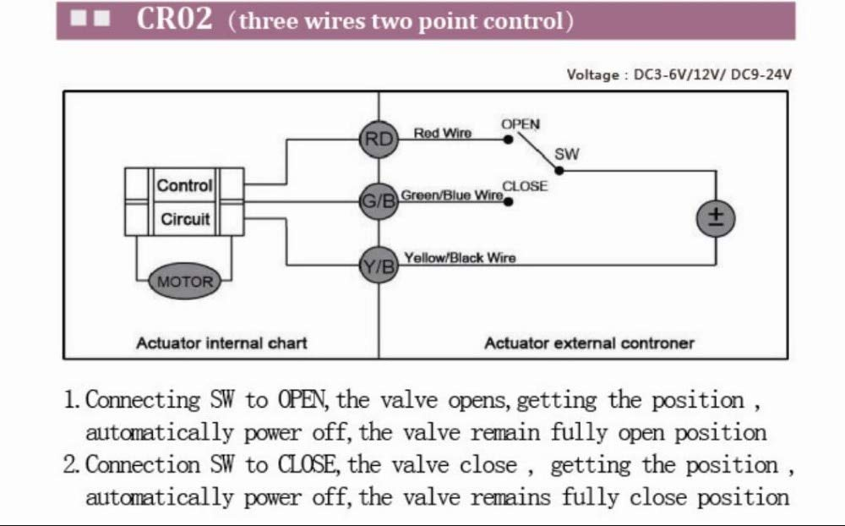
Electronic Ball Valves
Electric actuated ball valve
Model: CWX-15Q (CR02)
Q means Quick = open&close in 3 seconds
Max Current: 0.17A (2W)
Size:1/2"
Voltage: 12V DC
Material:Brass,Stainless 304
Wiring: 3 wirings

Slide 21
Valve Control Manual Open
In/out reversed

Slide 22
Valve Control Manual Closed
In/out reversed

Slide 23
Valve Control Auto Open
In/out reversed

Slide 24
Valve Control Auto Closed
In/out reversed

Slide 25
Chugger Pump and Heat Stick
DPDT switch shown as two switches
Switch is on 110VAC side
Opto coupler used to separate 110V AC for pump/element from status/RPi
Copy of the circuit for each component
Components
Chugger Pump
Heat Stick

Slide 26
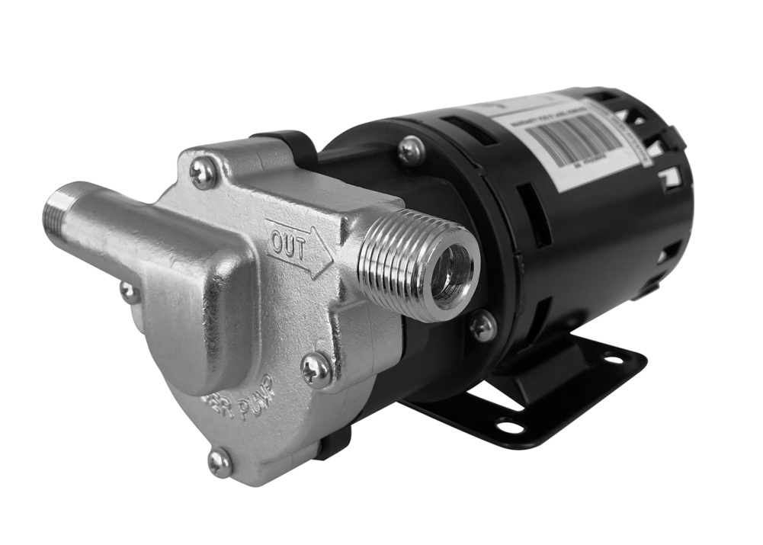
Chugger Pump
Not the X-dry version
Max Flow: 7 GPM
Max Head: 18.6 Feet
Horsepower: 1/20 HP
Voltage: 115 Volt
Hertz50 / 60 Hz
Current: 1.4A
Max Liquid Temperature: 250° F
Weight: 8 lbs
Dimensions: 6 x 5.25 x 4 inModelXCPSS-IN-1
Connections:
Inlet: 1/2″ MPT
Outlet: 1/2″ MPT
Not a self priming pump
The pump head must be flooded with liquid prior to turning the pump on.
If the pump squeels or makes loud noises, shut it down and make sure the head is full of liquid
To regulate the flow rate, it must be done on the output side of the pump
Recommended mounting the pump so the outlet faces horizontally to the right.
If this is not possible, the next best orientation is output facing up

Slide 27
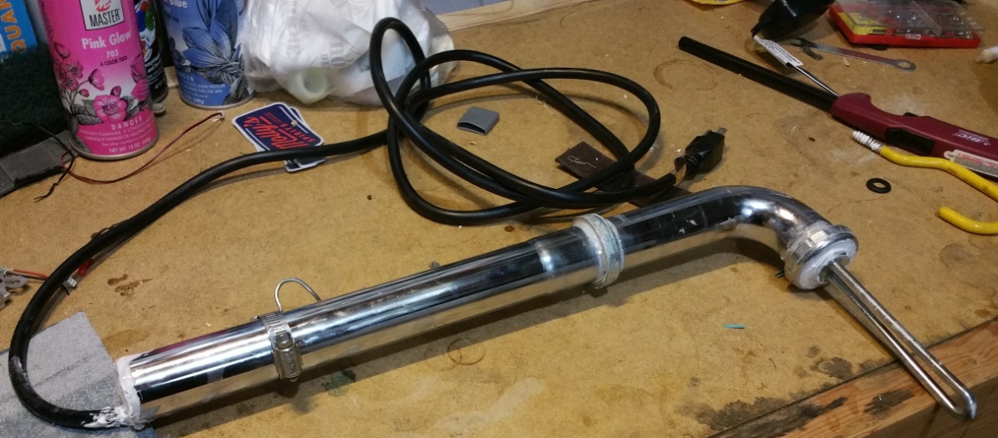
Heat Stick
Self Made Heat Stick
Element
1500W 120v hot water heater element
Current: 12.5A
Voltage: 120 VAC

Slide 28
Chugger Pump and Element Manual On

Slide 29
Chugger Pump and Element Manual Off

Slide 30
Chugger Pump and Element Auto On

Slide 31
Chugger Pump and Element Auto Off

Slide 32
Temp Sensors

Slide 33
Optocoupler SubCircuit On

Slide 34
Optocoupler SubCircuit Off
Wire removed to simulate off

Slide 35
In/Out Protection SubCircuit

Slide 36
Over Voltage Protection Simulation

Slide 37
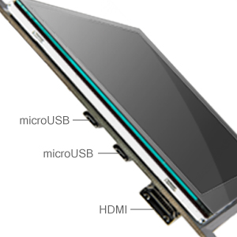
Lebula 7”USB Monitor
SPECS
Resolution: 1024x600
Contrast: 700:1
Aspect Ratio: 16:9/4:3
Average Brightness: 300cd/M2
Gamut Parameter: NTSC 50%
Refresh Rate: 60 Hz
Backlight Type: Highlight LED
Monitor Dimensions: 4.8"x6.5"x0.5"(HxWxD)
Monitor Weight: 0.5lb

Slide 38
RPi Pinout
Usage | schematic |  | function | Pin # |  | function |  | usage | schematic
 |  |  | 3V3 | 1 | 2 | 5V
(Future touchscreen) |  |  | GPIO2 | 3 | 4 | 5V
 |  |  | GPIO3 | 5 | 6 | GND |  | (Future touchscreen)
1-Wire | Sheet 7 |  | GPIO4 | 7 | 8 | GPIO14 |  | Valve 2, Open/Closed Status | Sheet 6
 |  |  | GND | 9 | 10 | GPIO15 |  | Valve 2, Auto En Status | Sheet 6
Valve 1, Open/Closed Status | Sheet 6 |  | GPIO17 | 11 | 12 | GPIO18 |  | Valve 2 Auto Open/Closed CMD | Sheet 6
Valve 1, Auto En Status | Sheet 6 |  | GPIO27 | 13 | 14 | GND
Valve 1 Auto Open/Closed CMD | Sheet 6 |  | GPIO22 | 15 | 16 | GPIO23
 |  |  | 3V3 | 17 | 18 | GPIO24
Chiller Pump Auto En Status | sheet 4 |  | GPIO10 | 19 | 20 | GND
Chiller Pump On/Off Status | sheet 4 |  | GPIO9 | 21 | 22 | GPIO25 |  | Recirc Pump Auto En Status | sheet 4
Chiller Pump On CMD | sheet 4 |  | GPIO11 | 23 | 24 | GPIO8 |  | Recirc Pump On/Off Status | sheet 4
 |  |  | GND | 25 | 26 | GPIO7 |  | Recirc Pump On CMD | sheet 4
DON’T USE, I2C for EEPROM |  |  | GPIO0 | 27 | 28 | GPIO1 |  | DON’T USE, I2C for EEPROM
 |  |  | GPIO5 | 29 | 30 | GND
 |  |  | GPIO6 | 31 | 32 | GPIO12 |  | Buzzer | ???
Chugger Auto En Status (OptoTLM) | Sheet 5 |  | GPIO13 | 33 | 34 | GND
Chugger On/Off Status (OptoTLM) | Sheet 5 |  | GPIO19 | 35 | 36 | GPIO16 |  | Element Auto En Status (OptoTLM) | Sheet 5
Chugger Auto On CMD | Sheet 5 |  | GPIO26 | 37 | 38 | GPIO20 |  | Element On/Off Status (OptoTLM) | Sheet 5
 |  |  | GND | 39 | 40 | GPIO21 |  | Element Auto On CMD | Sheet 5
https://www.raspberrypi.org/documentation/hardware/raspberrypi/schematics/rpi_SCH_3b_1p2_reduced.pdf
https://pinout.xyz/pinout/1_wire

Slide 39
Power Supply Usage
5V |  | Raspeberry Pi | Recirculation and Chiller Pump | Valves | Chugger and Element
 | Source 1 | X
 | Source 2 |  | X | X
 | Source 3
12V
 | Source 1 |  |  |  | X
 | Source 2 |  | X | X
 | Source 3
Source 3 (5V and 12V) left open as a spare
5V and 12V sources are all from the same singular source
There is no benefit to split out the boards to different

Slide 40
Power Budgets
2 110AC Circuits
12V Power Budget 5V Power Budget
Circuit 2 - Controller & Chugger
Power Supply | 3.6 | A
Chugger | 1.4 | A
Raspberry Pi | 0.23 | A
Display | 0.23 | A (estimate)
Circuit Breaker | 15 | Amps
Margin | 9.5 | Amps
Circuit 1 - Heat Stick
Heat Stick | 12.5 | A
Circuit Breaker | 15
Margin | 2.5
 | Amps | qty | total
Recirculation and Chiller Pump Circuit | 0.05 | 2 | 0.10
recirc pump | 0.83 | 1 | 0.83
chiller pump | 5.50 | 1 | 5.50
Valves Circuit | 0.03 | 2 | 0.06
valve | 0.17 | 2 | 0.33
Chugger and Element Circuit | 0.10 | 2 | 0.20
 |  | total | 7.03
 |  | Power Supply | 22.00
 |  | Margin | 14.97 | Amps
5V Power Budget
 | Amps | qty | total
Temp Sensor Circtuit | 0.081 | 1 | 0.08
Power Indicators | 0.0272 | 7 | 0.19
 |  | total | 0.27
 |  | Power Supply | 25.00
 |  | Margin | 24.73

Slide 41
Layout Notes
Skipping PCB for now (mostly because I’m not too famaliar with doing it
Board 1
Signal circuit protection
Temp Sensors
Power Rail LEDs
Power Rail Jumpers to other boards
RPi Switch
Board 2
Recirc pump
Valves
Board 3
12V side of Chugger Pump
Board 4
110V AC side of Chugger Pump
Including Optocoupler Sub Circuit

Slide 42
Connectors
External (non-110VAC)
XLR: Temp Sensors
M24: 12V pumps, chiller, valves
External (110VAC
3 prong outlet
Input to controller is GFCI
Internal
Terminal to board connectors

Slide 43
Wire Guage Chart
https://www.powerstream.com/Wire_Size.htm
WG gauge | Conductor Diameter mm | Conductor cross section in mm² | Ohms per 1000 ft. | Ohms per km | Maximum amps for chassis wiring | Maximum amps for power transmission | Maximum frequency for 100% skin depth for solid conductor copper
8 | 3.2639 | 8.37 | 0.6282 | 2.060496 | 73 | 24 | 1650 Hz
9 | 2.90576 | 6.63 | 0.7921 | 2.598088 | 64 | 19 | 2050 Hz
10 | 2.58826 | 5.26 | 0.9989 | 3.276392 | 55 | 15 | 2600 Hz
11 | 2.30378 | 4.17 | 1.26 | 4.1328 | 47 | 12 | 3200 Hz
12 | 2.05232 | 3.31 | 1.588 | 5.20864 | 41 | 9.3 | 4150 Hz
13 | 1.8288 | 2.63 | 2.003 | 6.56984 | 35 | 7.4 | 5300 Hz
14 | 1.62814 | 2.08 | 2.525 | 8.282 | 32 | 5.9 | 6700 Hz
15 | 1.45034 | 1.65 | 3.184 | 10.44352 | 28 | 4.7 | 8250 Hz
16 | 1.29032 | 1.31 | 4.016 | 13.17248 | 22 | 3.7 | 11 k Hz
17 | 1.15062 | 1.04 | 5.064 | 16.60992 | 19 | 2.9 | 13 k Hz
18 | 1.02362 | 0.823 | 6.385 | 20.9428 | 16 | 2.3 | 17 kHz
19 | 0.91186 | 0.653 | 8.051 | 26.40728 | 14 | 1.8 | 21 kHz
20 | 0.8128 | 0.519 | 10.15 | 33.292 | 11 | 1.5 | 27 kHz
21 | 0.7239 | 0.412 | 12.8 | 41.984 | 9 | 1.2 | 33 kHz
22 | 0.64516 | 0.327 | 16.14 | 52.9392 | 7 | 0.92 | 42 kHz
23 | 0.57404 | 0.259 | 20.36 | 66.7808 | 4.7 | 0.729 | 53 kHz
24 | 0.51054 | 0.205 | 25.67 | 84.1976 | 3.5 | 0.577 | 68 kHz
25 | 0.45466 | 0.162 | 32.37 | 106.1736 | 2.7 | 0.457 | 85 kHz
26 | 0.40386 | 0.128 | 40.81 | 133.8568 | 2.2 | 0.361 | 107 kHz
27 | 0.36068 | 0.102 | 51.47 | 168.8216 | 1.7 | 0.288 | 130 kHz
28 | 0.32004 | 0.080 | 64.9 | 212.872 | 1.4 | 0.226 | 170 kHz

